Slide 1
ENGLISH Premier league
SUCCESS PARAMETERS IN THE ENGLISH PREMIER LEAGUE(A DETAILED ANALYSIS)

Slide 2
INTRODUCTION
The Toughness of the English Premier League
The English Premier League (EPL) is widely regarded as one of the toughest and most competitive football leagues in the world. From the intensity of the fixtures to the unpredictable nature of the results, the EPL presents a unique challenge to clubs, managers, and players alike.
Relentless Competition
One of the defining characteristics of the EPL is the sheer level of competition. Unlike other leagues where a few dominant teams routinely claim the title, the Premier League has seen a more even spread of success, with surprise outcomes and underdog stories like Leicester City’s 2015–16 title win capturing global attention. Even teams in the lower half of the table are capable of beating the top sides on any given day, making every match a potential upset.
Many factors dictate the tough nature of the EPL such as High End physicality and pace, Fixture congestion, Fan pressure and media scrutiny, high-caliber talent and tactics amongst many others.

Slide 3
Goals of this analysis
Determine what factors guarantee winning the premier league.
What factors are consistent with the top teams that keep them considered top teams.
Analyzing trends over the years and Predict what top teams are likely to keep succeeding.

Slide 4
Steps taken in this analysis
Defining the objective
Data collection: in this case, Kaggle was the source for the raw data
Data cleaning
-Handle missing values
-Handle missing rows
-Correcting data types(converting home win, draw or away win to 3 points for wins and 1 points for draws) Home wins were recorded as ‘W’, Away wins as ‘A’ and draws as ‘D’
4. Data Exploration(EDA)
-Using SQL to collate home and away wins/draws for each teams to understand home and away form
-Query for Parameters such as yellow and red card, total scoring attempt, clean sheets and many more
5. Data Transformation
- Create and Join home and away Tables to get summary for each team.
-Create new variables like shooting percentage and Goal Difference
6. Interpretation and visualization

Slide 5
LETS GET INTO VISIALIZATION AND INTERPRETATION OF DATA

Slide 6
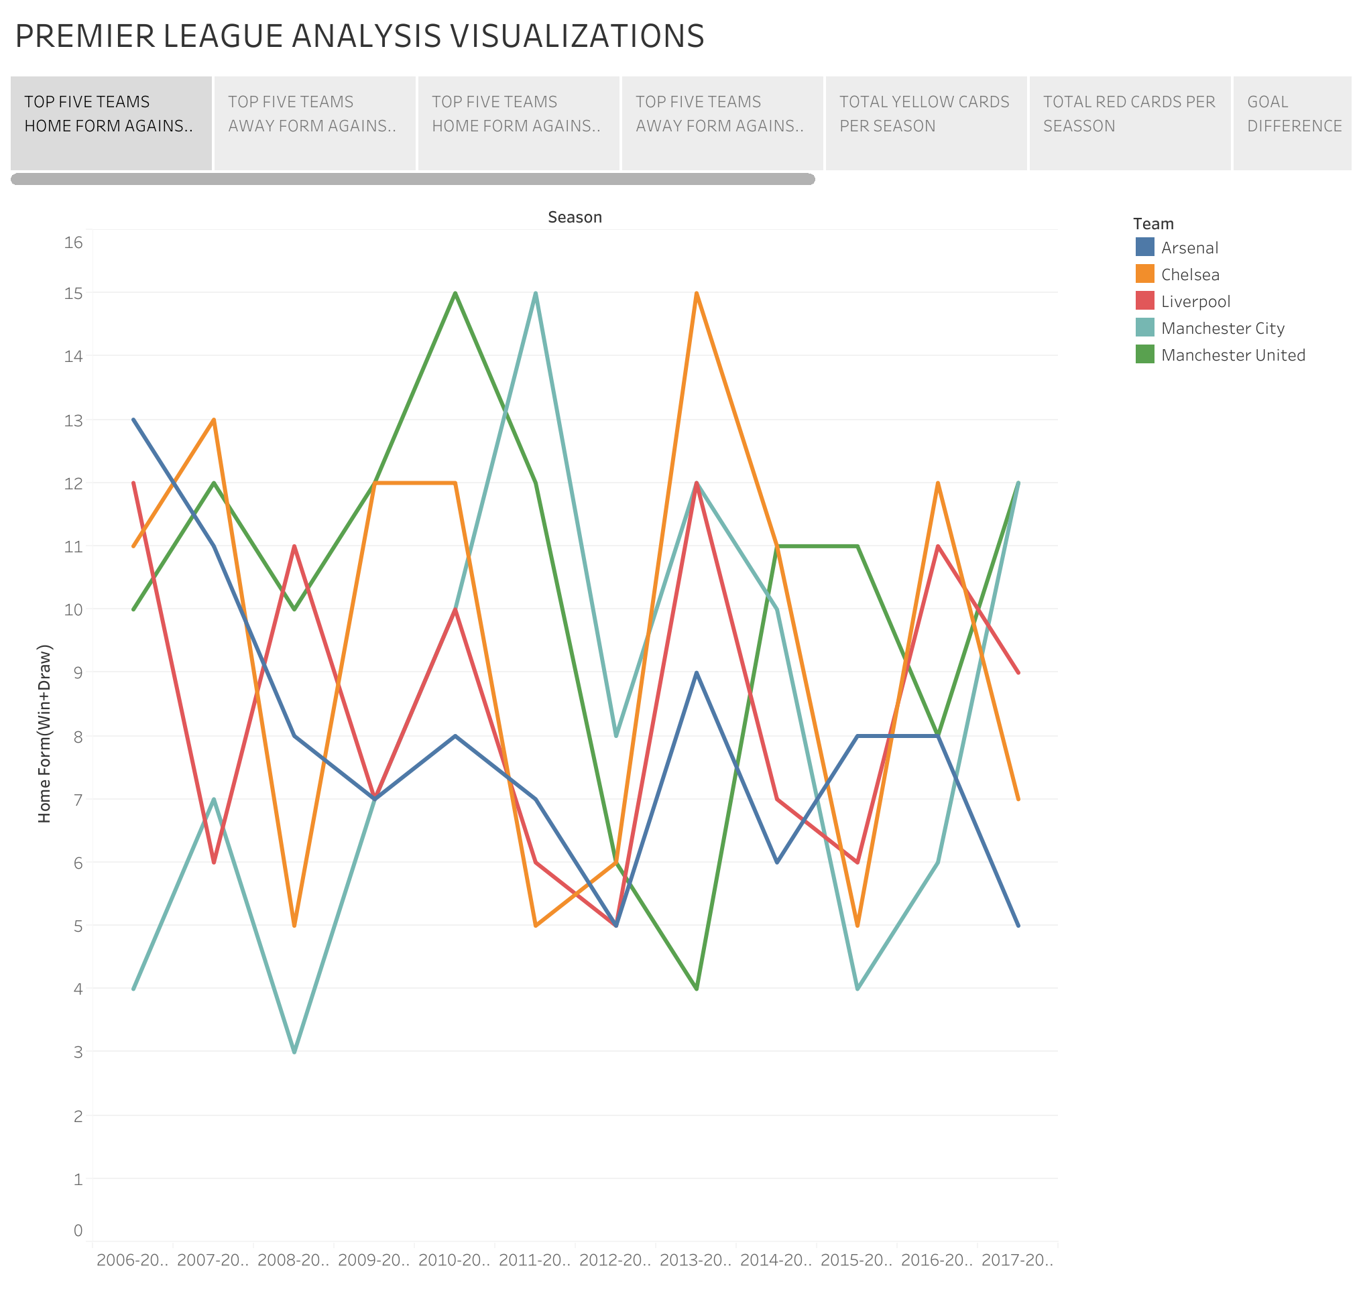
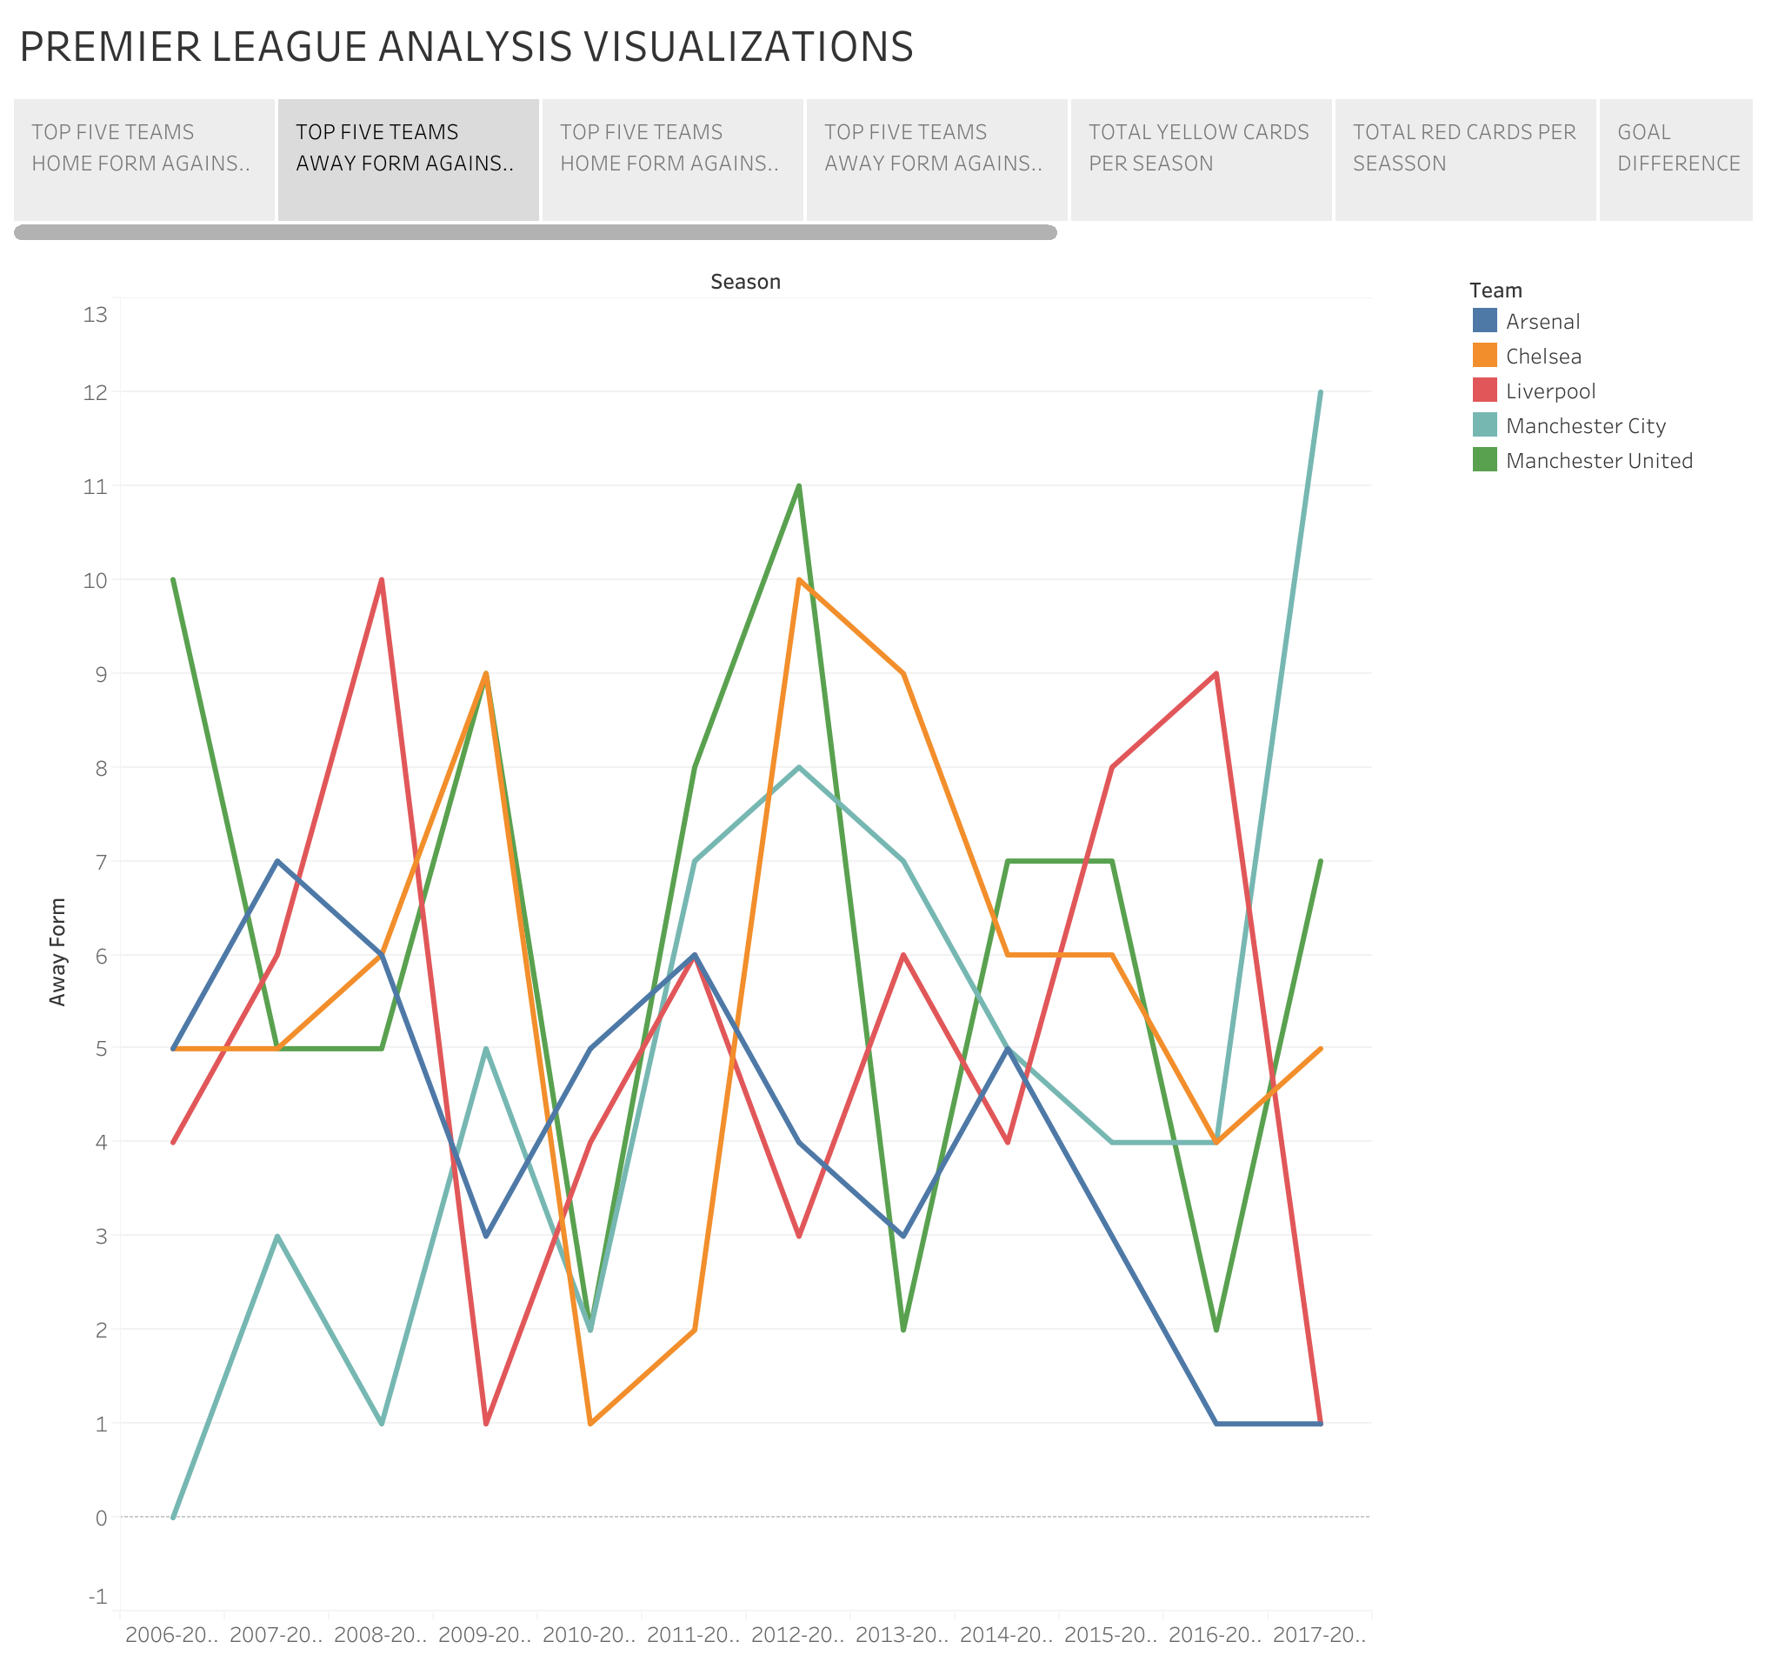
TOP FIVE TEAMS HOME AND AWAY FORM AGAINST THEMSELVES(BIG six)
Home Form
Away Form

Slide 7
Home and away form against the top 5 teams isn’t usually a clear, direct or the most important factor to who wins the premier league, teams might not necessarily do well against all the top teams but having a positive consistent form against every other team(low and mid class teams) could ensure one wins the league(Manchester united won the 08/09 while taking only 5 points out of possible 15 points against top teams away and 15 points total out possible 30 points, BUT they ended up with 50 HOME POINTS out of Possible 57 and 40 points Away(similar situations were Manchester united 12/13 season, chelsea 2016/2018 with 51 home points and 42 away points despite winning only 4 points against big teams away.
I did discover that Home and away form against big teams wasn’t a strong factor to decide who finishes strong in the league(Top 5), while many top teams have decent record against their top counterparts many times teams have poor performance against big teams but still finished top 5 because of excellent form against every other middle/low class teams.

Slide 8
-For instance over the years analyzed(12 seasons) Arsenal featured the highest in the top 5 picking a spot in the top 5 for 11 years out of possible 12(finishing 3rd 4 times, 4th 5 times, and 5th once), but they have the lowest points accumulated over the 12 year period, meaning even if they performed poorly against the top teams over the home and away course, they did fairly well against the other teams each season.
-Man city with the second lowest points across the 12 seasons managed to feature in the top five 9 times out of 12, whilst winning the league 3 times and finishing second 2 times.
-Liverpool had the 3rd highest points H2H against other top 5 teams across the 12 seasons but were still last placed(6th) in number of times they appeared in in top 5, only 6 out of 12. This indicates that points against top six is not as important as consistency against all teams. CONSISTENCY BEATS BIG WINS.
While Big Wins may not be the all important or deciding factor in who finishes top 5, it certainly plays a minor part, because a win against a top rival not only gives a big 3 point to the victor but deprives the loser of an important 3 point in the race for top 5(once again, this loss or win can be offset by good performance against all other teams).
Teams that end up in top 5 usually get (11)and above of the possible (30) points available from big teams home and away. Going below 11 points would mean the team wont end up in the top 5. EACH 6 TEAMS HAVE 12 SEASONS WHICH IS 72 OUTCOMES IN TOTAL, ONLY IN 7 EXCEPTIONS(9.7%) DID A TEAM GO BELOW 11 POINTS A SEASON AND STILL MADE TOP 5

Slide 9
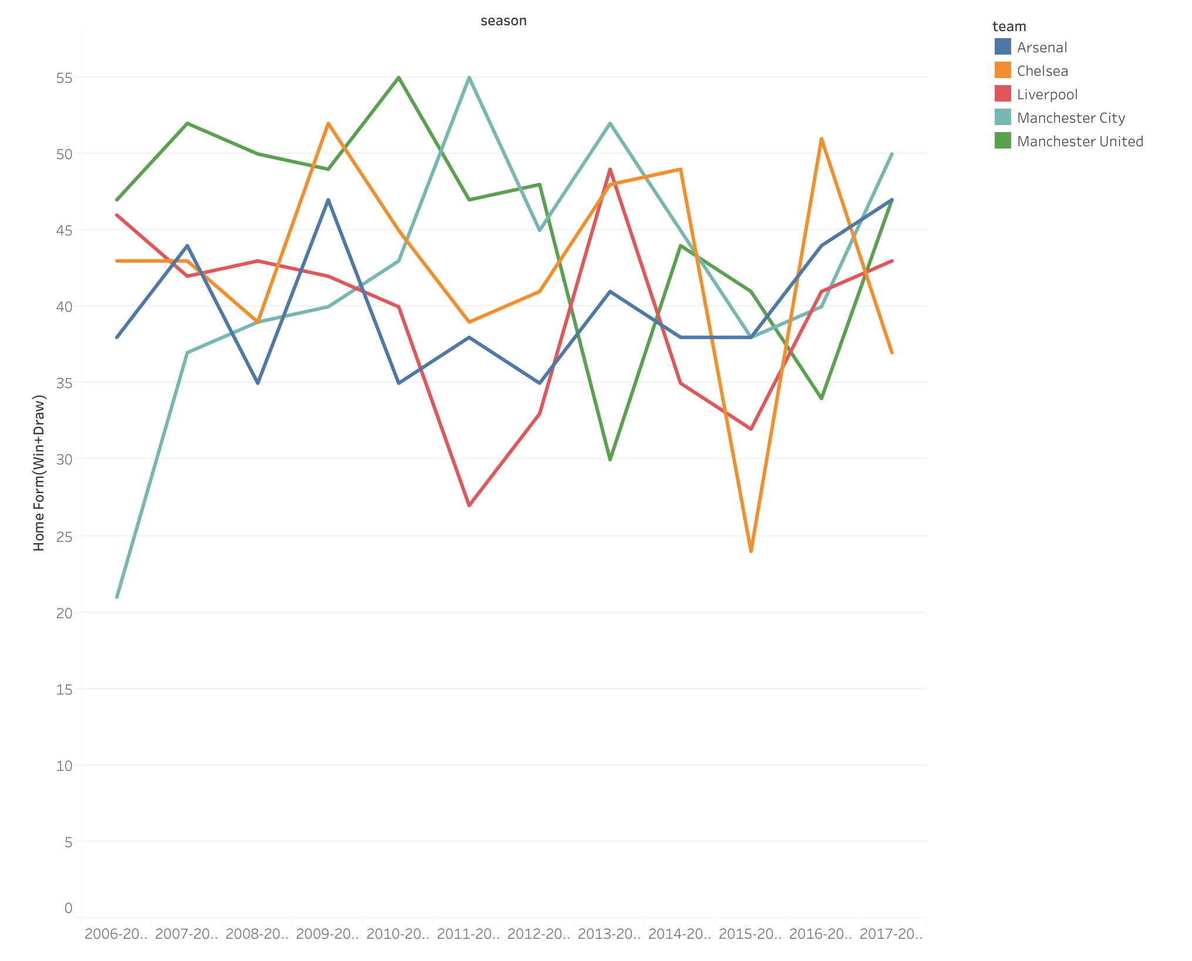
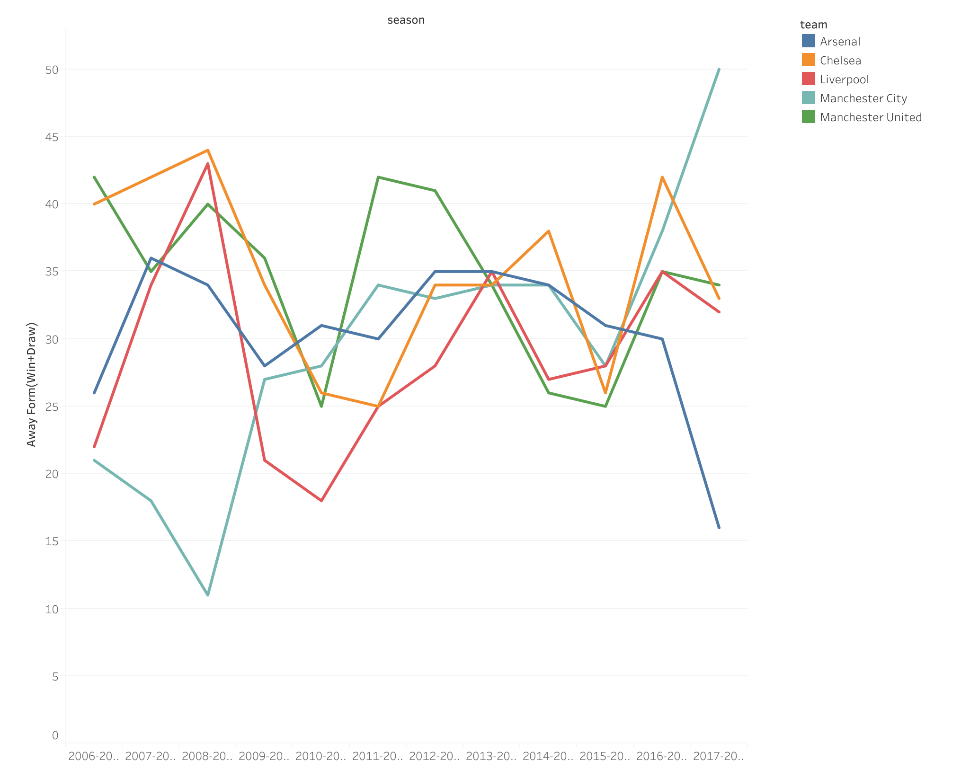
TOP FIVE HOME AND AWAY FORM AGAINST ALL TEAMS
HOME FORM
AWAY FORM

Slide 10
All top teams tend to have very good Home form meaning they displayed home dominance across the entirety of the season. In fact only twice in 60 outcomes did teams have better away form than home form and one team barely made top 5 while the other team didn’t make top 5(Manchester united for the first time in 10 years didn’t make top 5). This shows the importance of home form and how rare it is to see away form be better than home form.
All title winning teams are dominant at home than away, ALWAYS. Top 5 teams are dominant at home, even mid table teams are usually dominant at home. The difference between Title winners and other teams is how well they perform at AWAY games, it is also the difference between top 5 and mid level teams i.e Man city had better home games than Chelsea and Arsenal in 2008/2009 but failed to finish above them or even in top 5 (FINISHED 10TH) because of a poor 11 point away record.

Slide 11
In Summary
-Home form is Foundational (Most teams tend to win at home)
-Away form is the separator (Title winners have very good home form, top 4 teams have decent away form, mid level teams struggle with away form.
-Elite teams dominate Both while relegation teams fail everywhere.
- clubs with poor home performance rarely break into top 6 except they have overperformed away which is rare
CLUBS PERFORM BETTER AT HOME BECAUSE OF FAN SUPPORT AND TACTICAL ADVANTAGE.

Slide 12
Yellow and red cards
Discipline isn’t a big nor deciding factor when it comes to success in the premier league but the presence of a good number of yellow cards has shown a teams physicality and no nonsense defending but just like the game of football cautions against excessive physicality, so does this analysis. Teams that tend to go over board with yellow cards usually get affected by suspensions.
Top teams avoid extremes(they are not the most disciplined but they are not reckless)
Red cards getting into 4 or 5 can derail a season
Relegation teams are either too soft(too disciplined) or too hard(too reckless)

Slide 13
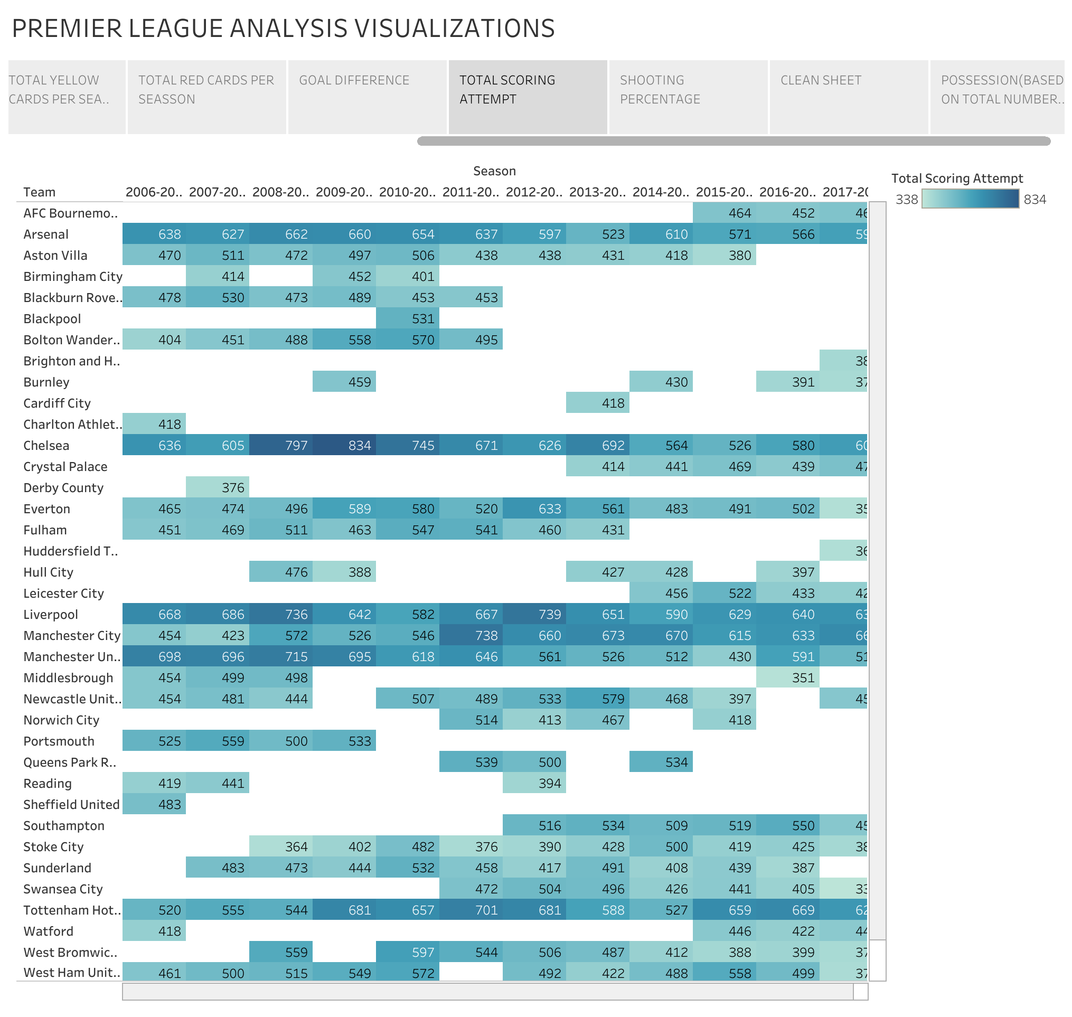
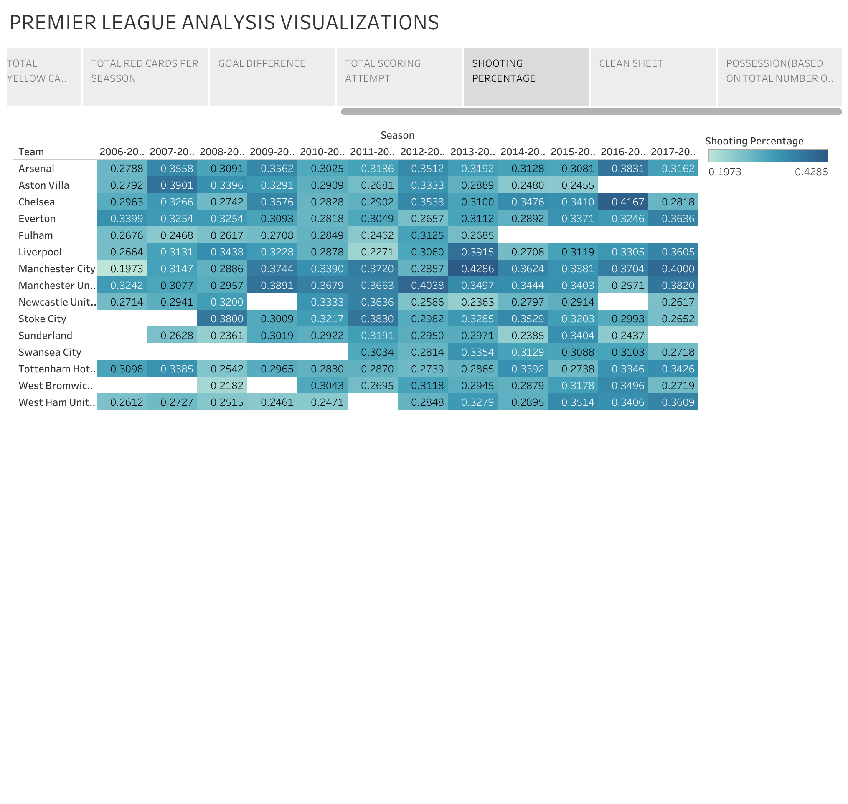
Total scoring attempt and shooting percentage
Total scoring attempt
Shooting Percentage

Slide 14
Title winning teams dominate total scoring attempt
Manchester United (2006–09, 2010–13):
2006–07: 698 attempts (1st in league).
2008–09: 715 attempts (1st in league).
Chelsea (2009–10, 2014–15, 2016–17):
2009–10: 834 attempts (1st in league).
2016–17: 580 attempts (1st in league).
Manchester City (2011–12, 2017–18):
2017–18: 665 attempts (1st in league).
Top 2 highest teams in scoring attempts won the league 8 out of 12 seasons
Top 5 teams usually rank high in attempts
Relegated teams usually rank bottom 3 in attempts
BUT EFFICIENCY (SHOOTING PERCENTAGE) MATTERS MORE AND SO DOES A SOLID DEFENSE

Slide 15
Efficiency Separates Elite Teams:
Chelsea (2016–17): 580 attempts but 85 goals (best conversion rate).
Arsenal (2015–16): 571 attempts but 65 goals (poor efficiency).
Top teams consistently have high conversion rates meaning they don’t just have more on target attempts but they convert them to goals more efficiently.
Manchester United (2012-2013): 40.38% conversion rate.
Chelsea (2016-2017): 41.67% conversion rate.
Manchester City (2017-2018): 40% conversion rate.
Manchester City’s Rise: Their conversion rate improved significantly from 19.73% (2006-2007) to 40% (2017-2018), mirroring their transformation into a dominant force.
Even Leicester city unlikely title winning season showed very significant improvements in shooting percentage/efficiency over their previous poor years.
The conversion rate is a strong and clear indicator of success in the EPL

Slide 16
CLEAN SHEETS
Title winning teams dominate clean sheet rankings
Manchester United (2008–09) – 24 clean sheets (league record in this era).
Chelsea (2006–07, 2007–08, 2014–15) – Consistently topped clean sheet charts (e.g., 22 in 2006–07).
Manchester City (2011–12, 2017–18) – 17+ clean sheets in title-winning seasons.
Leicester City (2015–16) – 15 clean sheets (key to their shock title win).
One of the Top 2 Teams in Clean Sheet are usually league winners, happened 9 out of 12 seasons
-A minimum of 12 clean sheets was usually needed for a top 5 Position.
-Teams with fewer than 10 clean sheets rarely qualified for CL Qualification
-Relegated teams had the fewest clean sheets(Teams with less than 7 clean sheets were relegated in 10 out of 12 seasons)
Defensive Consistency Separates Elite Teams and clearly indicates title challenging seasons
Chelsea & Man United – Averaged 16–20 clean sheets per title-winning season.
Man City’s Rise – Improved from 10 clean sheets (2008–09) to 18 (2017–18) as they became dominant.
Liverpool’s Progress – Jumped from 10 (2013–14) to 17 (2017–18) as they challenged for titles.
Clean sheets are more important than goals because a clean sheet guarantees at least a draw and 3 points if they win. TO WIN THE LEAGUE, PRIRIOTISE A WORLD CLASS KEEPER AND ORGANIZED DEFENSE OVER SIGNING A STAR STRIKER

Slide 17
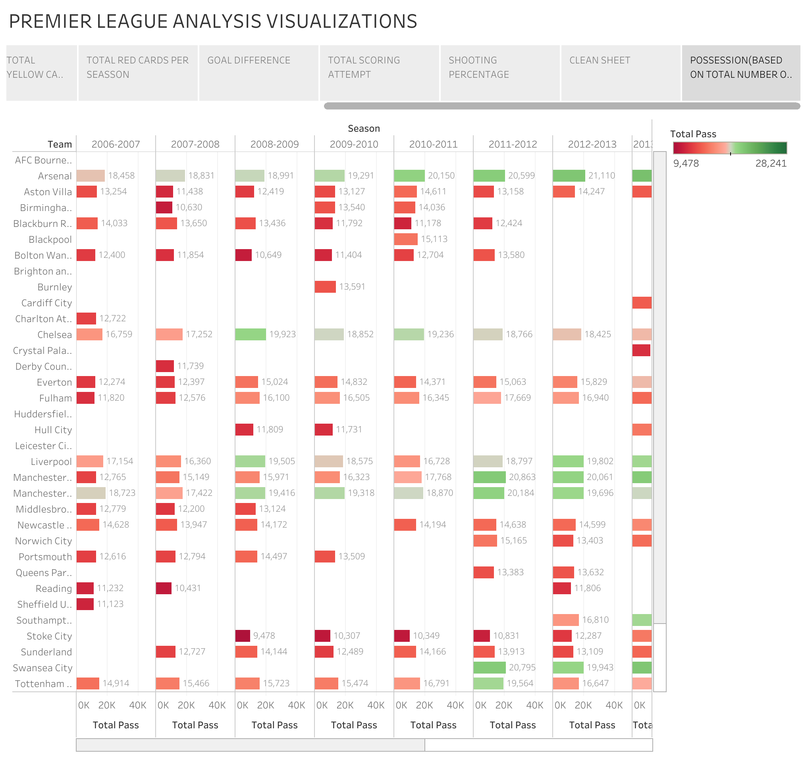
POSSESSION(USING TOTAL NUMBER OF PASSES)

Slide 18
Title winning teams Dominate possession
Top 3 teams in passes each season won the league 9 out of 12 seasons
Top 4 teams are always usually top 5 highest passing teams per season, they average 18,000-23,000 passes per season.
But possession is never enough to make any difference, chance creation is very important, Everton averaged 14,000-18,000 passes from 2006-2018 but remained mid table same with Swansea who averaged 20,795 passes in 2011-2012(second in volume but still finished 11th) because of the lack of a good striker.
Teams with ≤14,000 passes were relegated in 8 of 12 seasons.
Possession is important because it reduces the number of attacks the opponent can throw at you but you must make forward passes rather than side passes to increase your chance creation

Slide 19
FINAL SUMMARY
FACTORS THAT DIRECTLY INFLUENCE SUCCESS IN THE ENGLISH PREMIER LEAGUE
-Consistency Over Big Wins
-Keep Home form but put more effort into Away form, that’s where title winners shine
-Hold more possession because it reduces defensive errors and defensive work but MOST IMPORTANTLY play a more direct style of play so passes don’t just go back and sideways(focus on players and talents that can cut through defenses and have vision)
-Be more clinical and efficient with chances
-Clean sheets guarantee a draw(1 point) at the least
-Financial investments transform teams into title winners, Money buys top ranked players and coaches(this is why many small and middle level clubs have never had top level success) i.e Man city post 2010 after Etihad investments and Newcastle in recent years after investments show that money is the biggest factor to guarantee Success. Big teams have commercial revenue and broadcasting money and that’s why they remain top.

Slide 20
Other things Investment and Revenue can provide that guarantees success are
-World class infrastructure and facilities such as stadiums, youth academy, training grounds
-Global branding and fan engagement
-Data driven scouting, selling for profit, and Academy success
Future Predictions:
Man City & Liverpool will stay at the top due to financial and structural advantages, balanced performances, and squad depth.
Newcastle could rise if they spend wisely post-takeover.
Brighton & Brentford will remain smart overachievers.
Man United & Chelsea need stability to return to dominance.

